Slide 1
Air Pressure and Winds
Notebook Page 78
http://www.youtube.com/watch?v=O_1J23uLtPY
www.youtube.com/watch?v=2WJVHtF8GwI

Slide 2
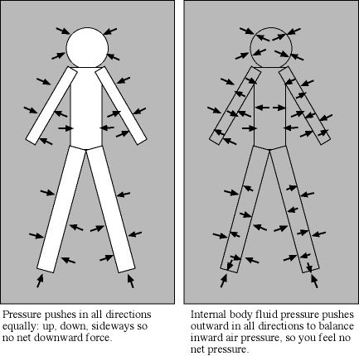
Air molecules are constantly moving, bouncing off of each other. Air pushes in ALL directions.
Air pressure= PRESSURE EXERTED BY THE WEIGHT OF AIR ABOVE

Slide 3
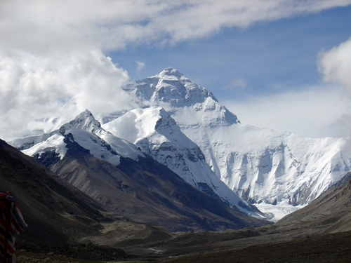
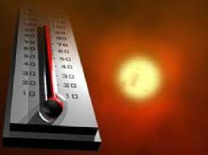
Air pressure DECREASES as you increase altitude. Air pressure INCREASES as temperature DECREASES.

Slide 4
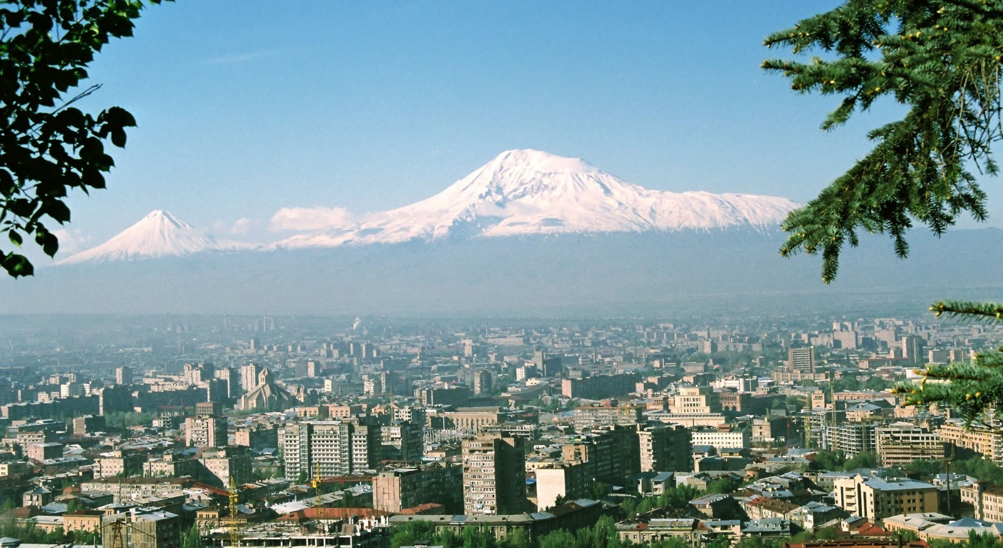
Where is there higher air pressure?
IN THE CITY

Slide 5

Where is air pressure higher?
COLDER AIR HAS MORE MOLECULES IN IT
HIGH PRESSURE LOW PRESSURE

Slide 6

Because of differences in pressure, air moves from areas of HIGH pressure towards areas of LOW pressure. If the door of the house was opened, how would the air molecules move? Why? COLD AIR MOVES INSIDE THE HOUSE, AIR MOVES FROM AREAS OF HIGH PRESSURES TO LOW PRESSURE

Slide 7
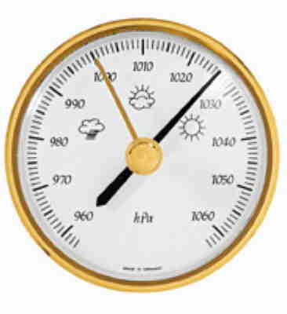
A BAROMETER is a tool used to measure air pressure. What element is used in barometers? MERCURY When air pressure INCREASES, the mercury in the barometer rises. When air pressure DECREASES, so does the mercury.

Slide 8
WIND FORMATION
WIND is air that moves parallel to the ground and is caused by the UNEQUAL heating of Earth’s surface. This unequal heating causes temperature differences that cause areas of AIR PRESSURE differences in the atmosphere. Air flows from areas of HIGH pressure to areas of low pressure.

Slide 9
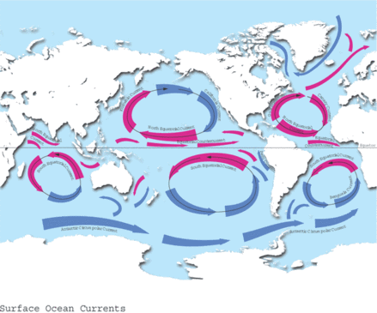
The Coriolis effect causes wind and water to bend due to the ROTATION of the Earth. In the northern hemisphere winds curve to the RIGHT and to the LEFT in the southern hemisphere.
www.youtube.com/watch?v=IWjeHtdpFjE

Slide 10
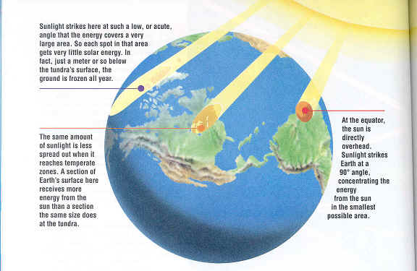
GLOBAL winds travel long distances in steady patterns for weeks.

Slide 11
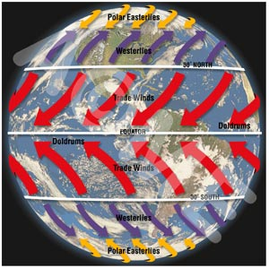

Slide 12
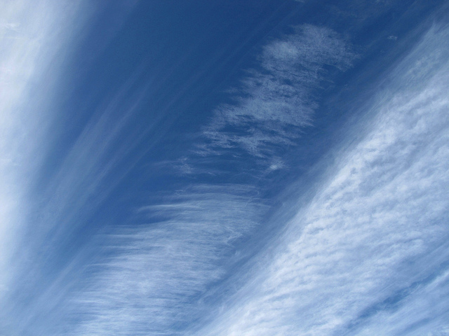
JET STREAMS are fast moving winds that travel between 120 and 240 km/hr in a west to east direction. Jet streams are located near the top of the TROPOSPHERE. Because jet streams are located at high altitude, FRICTION does not play a role in slowing down wind movement.

Slide 13
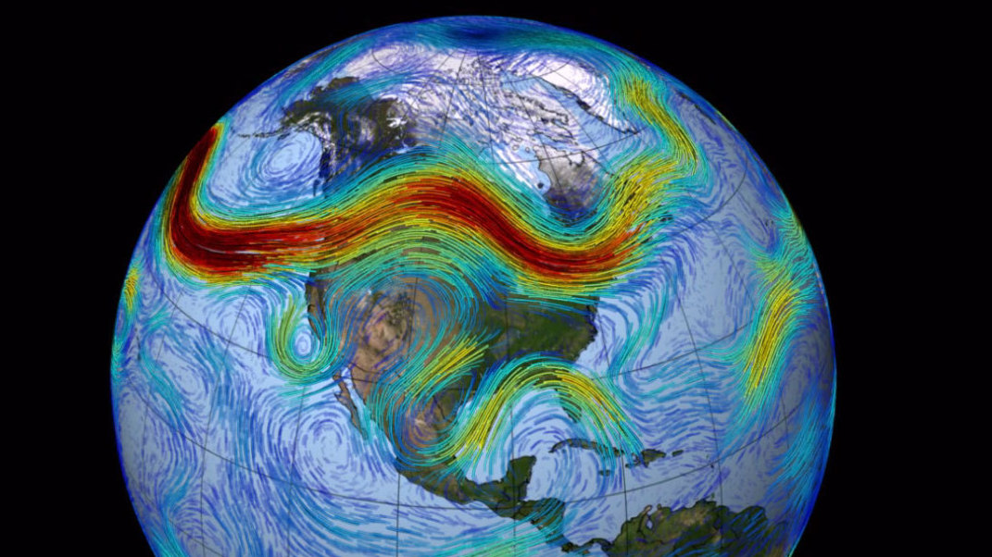
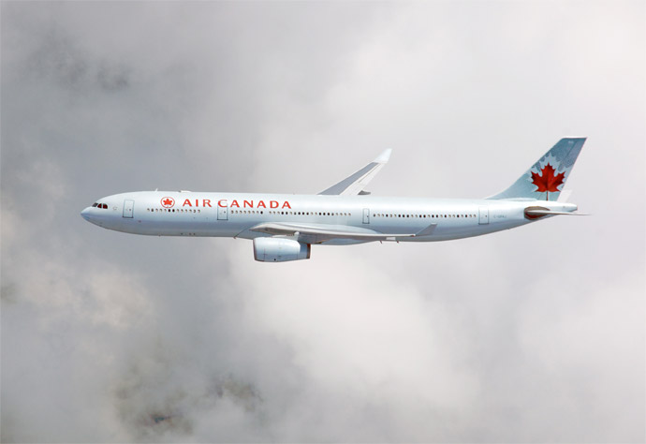
Planes traveling west to east will save FUEL and TIME by traveling the jet stream.

Slide 14
Local Winds
CONVECTION currents over areas where the land meets the sea cause sea breezes and land breezes. Sea breezes are created during the DAY because solar radiation warms the land more than the water. Air over land is heated, becomes less dense, rises and creates and area of LOW pressure. Cooler air over the water at a higher pressure moves toward the land.

Slide 15
At night, LAND cools much more rapidly than the ocean. Air over the land becomes cooler than the air over the ocean. The cool, dense air from the land moves out over the water, pushing the warm air over the water upward. Movements of air toward water are called LAND breezes.

Slide 16
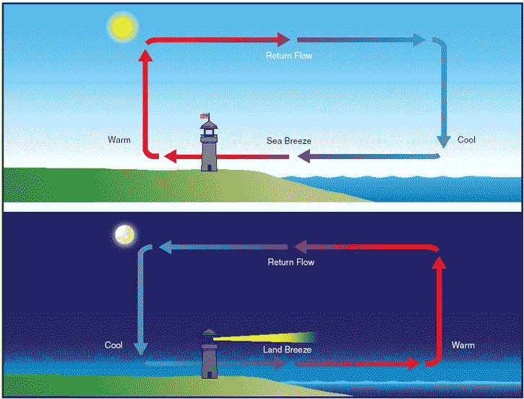

Slide 17
Seasonal Winds
MONSOONS are seasonal changes in wind direction. During warm months, areas such as India experience a flow of warm, wet air from the Indian Ocean, which produces the RAINY summer monsoons. During cold months, land is cooler than the ocean, air flows away from the land bringing DRY weather. http://www.youtube.com/watch?v=1Qtf7M1s__w

Slide 18
Wind Direction/ Wind Speed
A WEATHER VANE is and instrument used to measure weather direction. Winds are always labeled by the direction from which they blow. A north wind blows from the north toward the south. When wind consistently blows more often from one direction than from any other, it is called a PREVAILING wind. A cup anemometer is commonly used to measure wind SPEED.

Slide 19
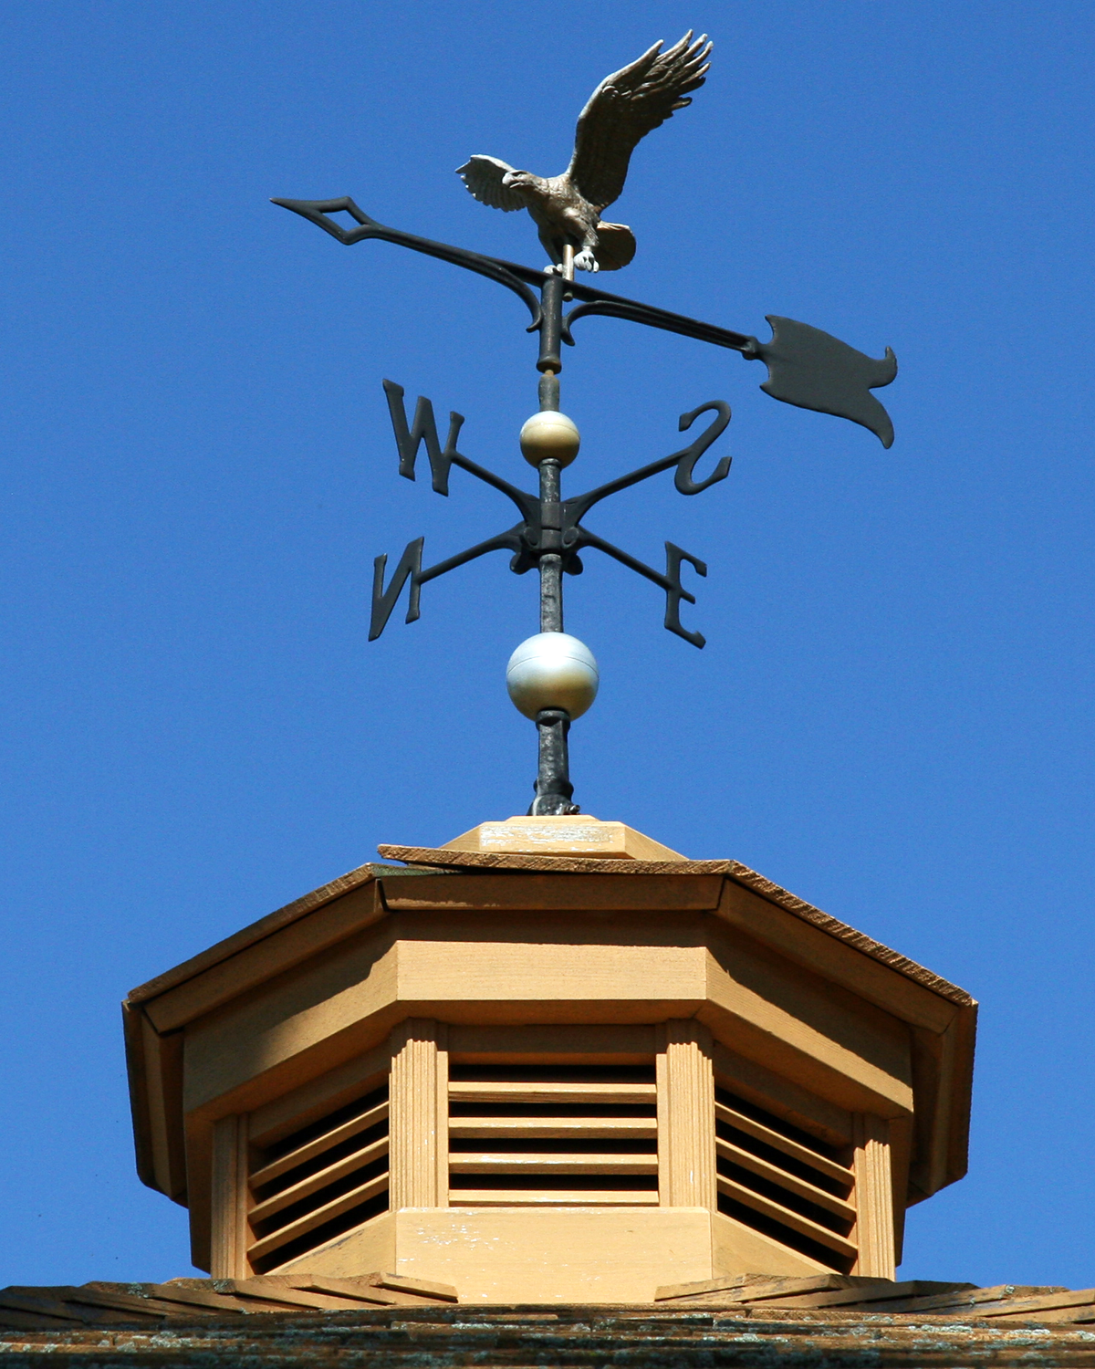
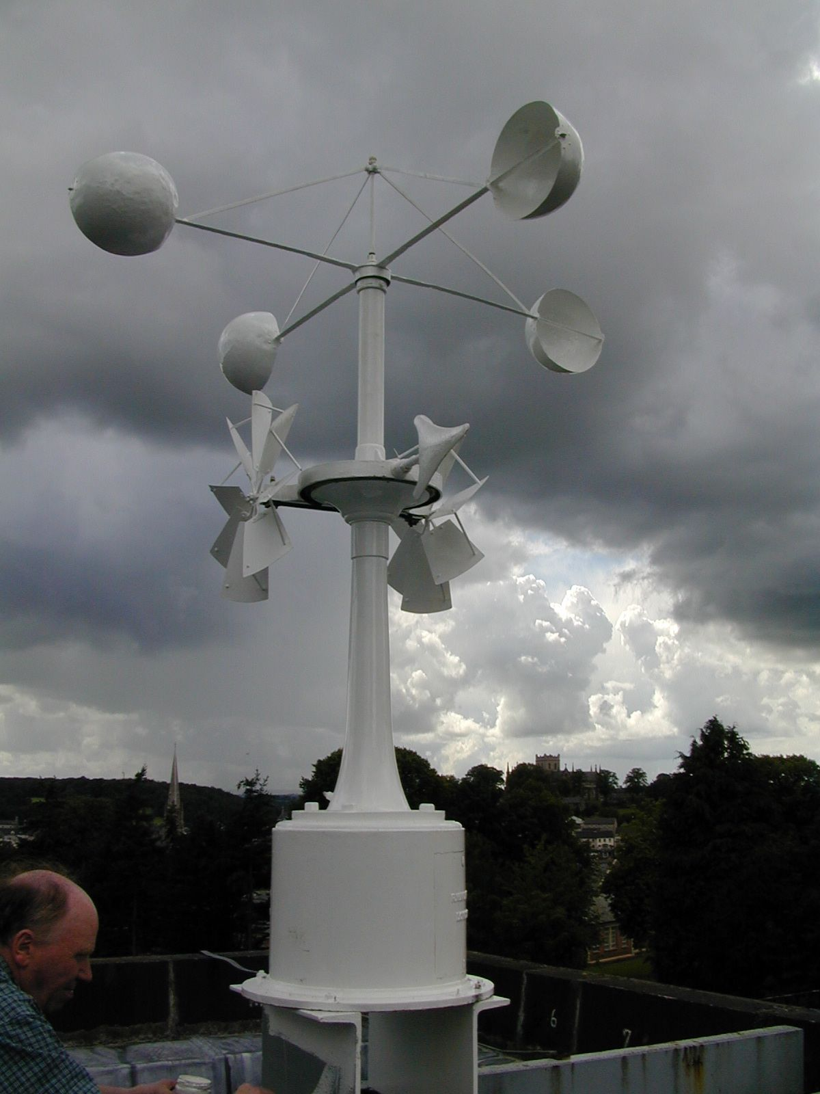

Slide 20
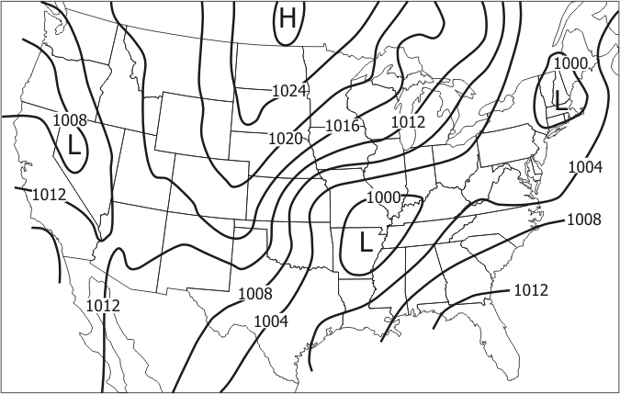
ISOBARS are lines on a map that connect places of equal air pressure. The pressure GRADIENT is the amount of pressure change occurring over a given distance. Closely spaced isobars indicate STRONG winds.

Slide 21
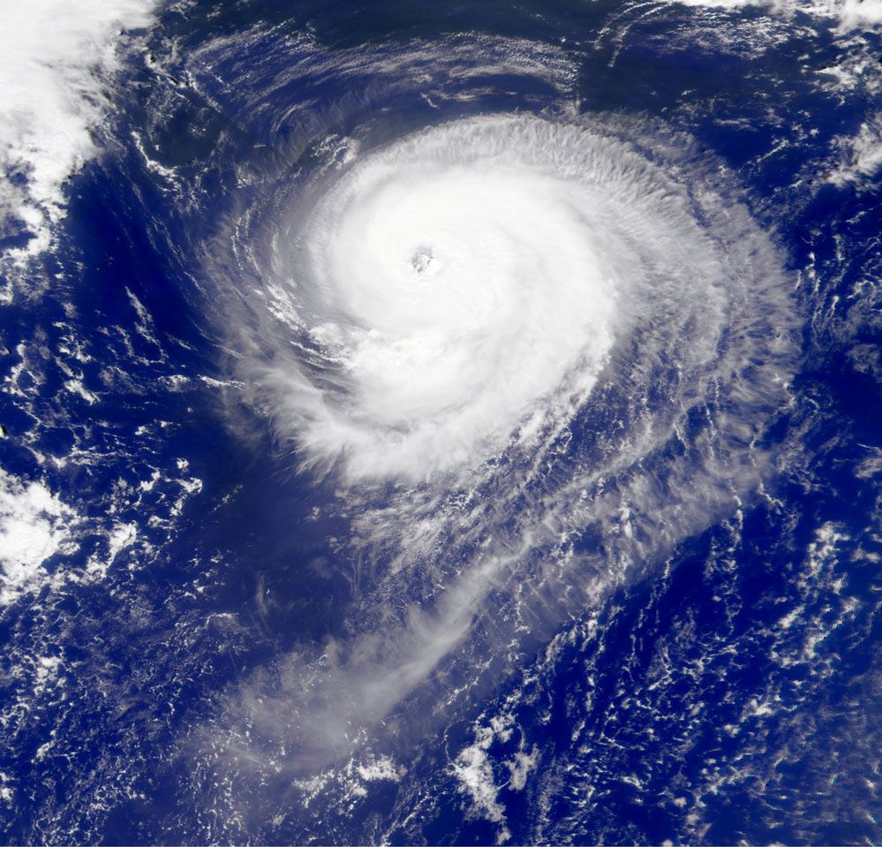
Lows or CYCLONES are centers of low pressure. Highs or ANTICYCLONES are centers of high pressure.

